Slide 1
Analysing the Importance of different weight factors on Weighted PageRank Algorithm
Akanksha Bhosale
Isha Potnis
Shantanu Sengupta

Slide 2
Key Points :
First PageRank Algorithm
History behind previous Algorithms and their cons
Idea behind the proposed algorithm
Our research question
Architecture
Our experimental approach
Results
Observation and Conclusions

Slide 3

Motivation for research
PageRank Algorithm - Where it fails ?
Weighted PageRank - An Improvement
Modified Weighted PageRank - moving beyond inlinks-outlinks
Proposed Weighted PageRank - giving importance to what matters more

Slide 4

Original Proposed Work
Factors contributing to efficient PageRank :
page popularity
page history
user preferences
content of the document

Slide 5
Our Research Question
Some factors play a more dominant role in returning more relevant pages than others.
In this research, we have selected two query dependant and two query independent factors and we focus sharply to find out which weight factor is more dominant in returning the most relevant results and by what factor, on the basis of a user study.

Slide 6
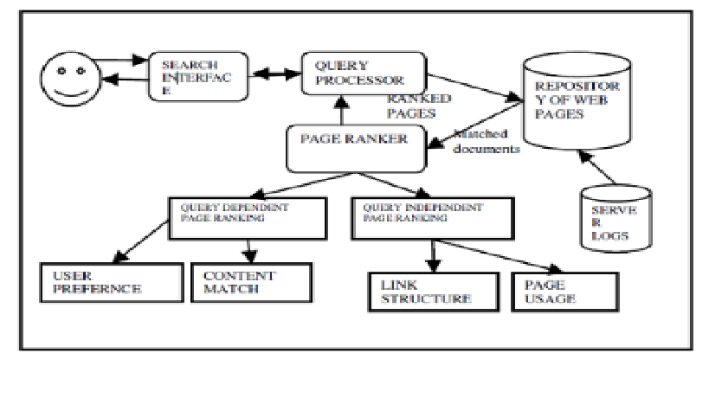
Architecture of the proposed model:
User preference and Feedback-based approach

Slide 7
Our Experimental Approach to the problem
Main modules in this experiment :
PageRank based on query dependent weight factors
Page Ranking based on query independent weight factors
Page Ranker module collects results from the individual modules and determines the importance of every factor in producing most relevant results.

Slide 8
Results of our experiment
To be included after the completion of experiment

Slide 9
Significant Observations
To be included after the completion of experiment

Slide 10
Challenges faced
To create different distributions for the different factors and figuring out the matrix for deciding optimal solution to research question.
To figure out how to assign weights to the different factors and on what basis will one factor be weighted more than other and by what scale.
Collecting user preferences from the actual users.

Slide 11
Conclusion to the research question
To be determined from the results of the experiment

Slide 12

Thank you

